Slide 1
PROTOTYPING & SYSTEMS ENGINEERING
TEAM A4
MIR SHARJIL HASAN
TALHA KHAN
MOHAMMAD HAMAS

Slide 2

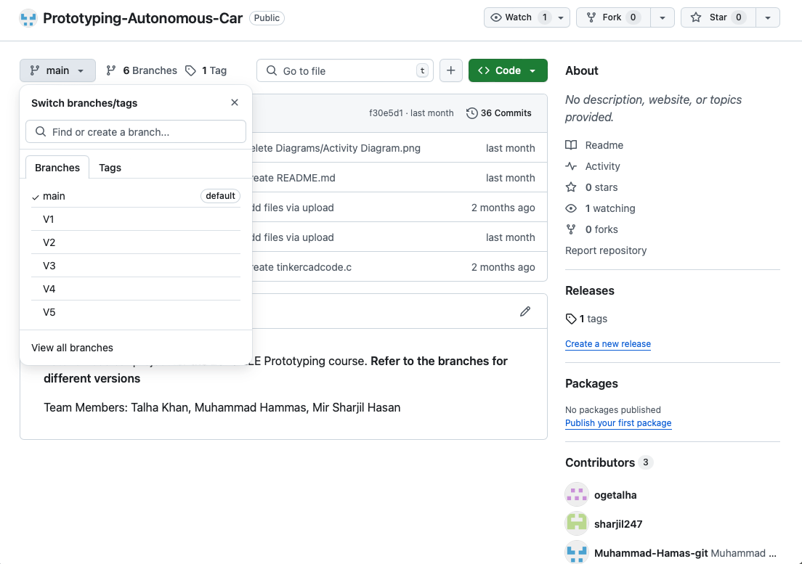
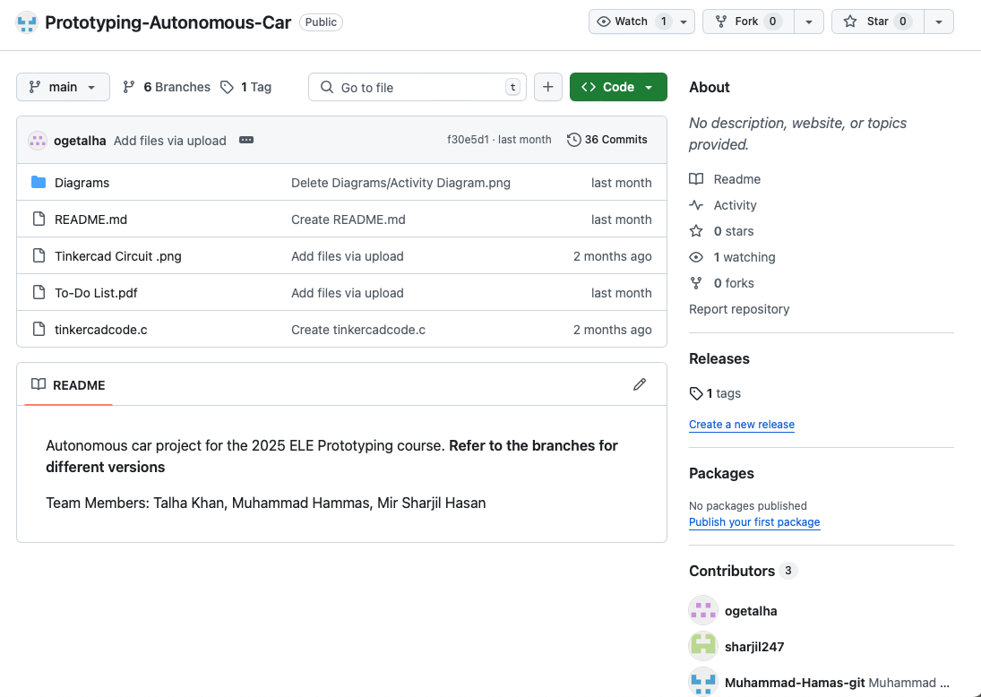
Work-load distribution
1

Slide 3
REQUIREMENTS:
Can Follow a Line?
Can optimize speed ?
Can detect obstacles?
Can take 90 degrees turn?
Can evaluate colour of Object?
Can take 180 degrees turn?
Can overtake an obstacle?
Can park?
2

Slide 4
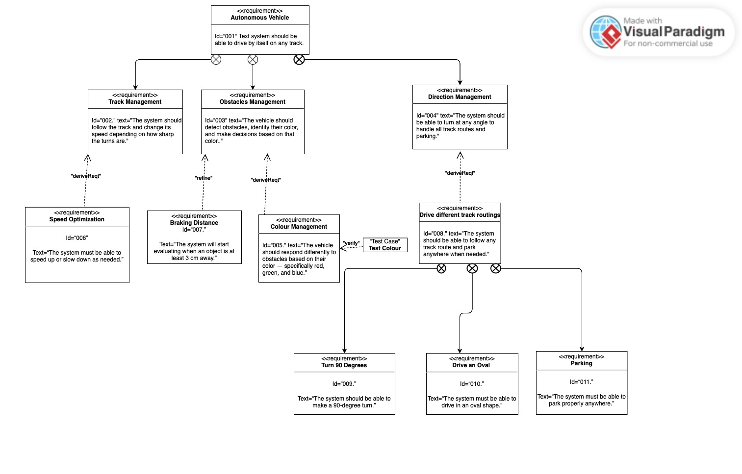
REQUIREMENT DIAGRAM
3

Slide 5
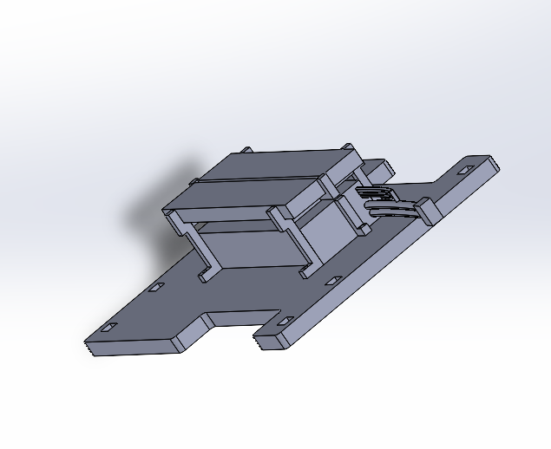
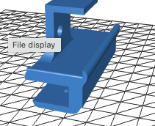
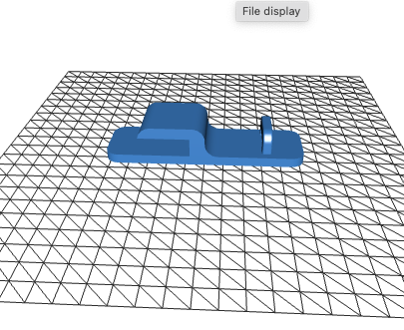
SOLIWORKS DESIGN
[1]
4

Slide 6
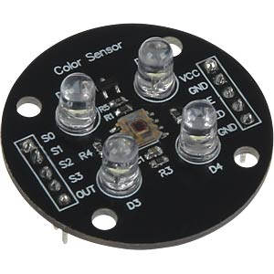
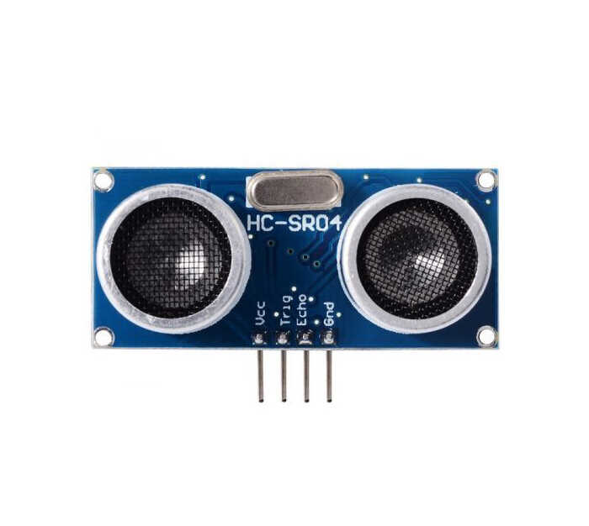
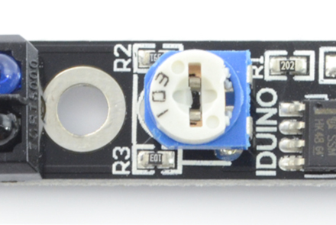
SENSORS
Sensor for Obstacle Detection
Sensor for Line Change Detection
Sensor for Obstacle Colour Identification
[2]
5

Slide 7
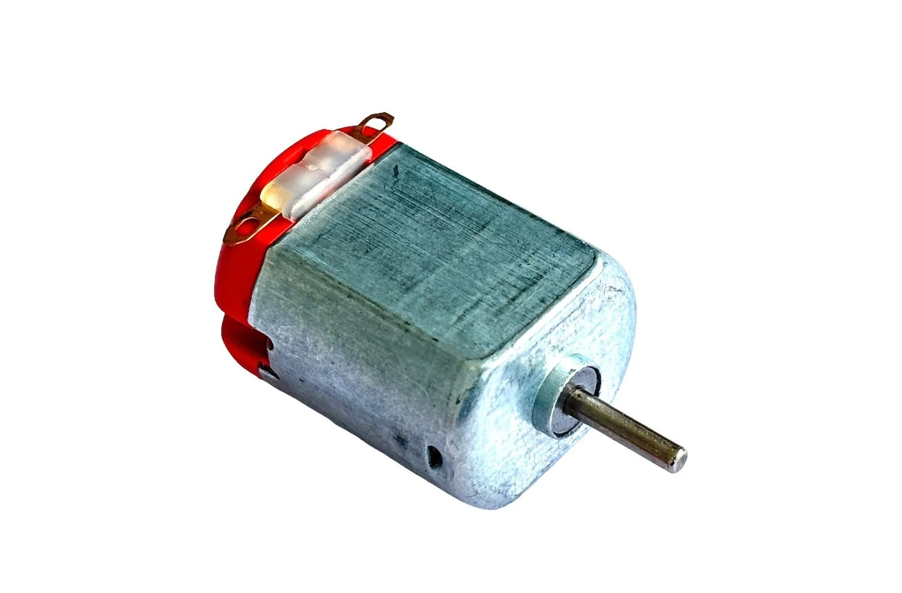
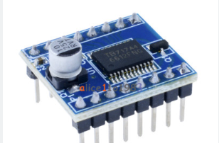
ACTUATORS
To enable the car to move in any direction.
Motors.
L298N Motor Driver
Input of 12V from Battery.
Output of 5V to Arduino
Used to control speed and
direction of DC Motors.
[3]
6

Slide 8
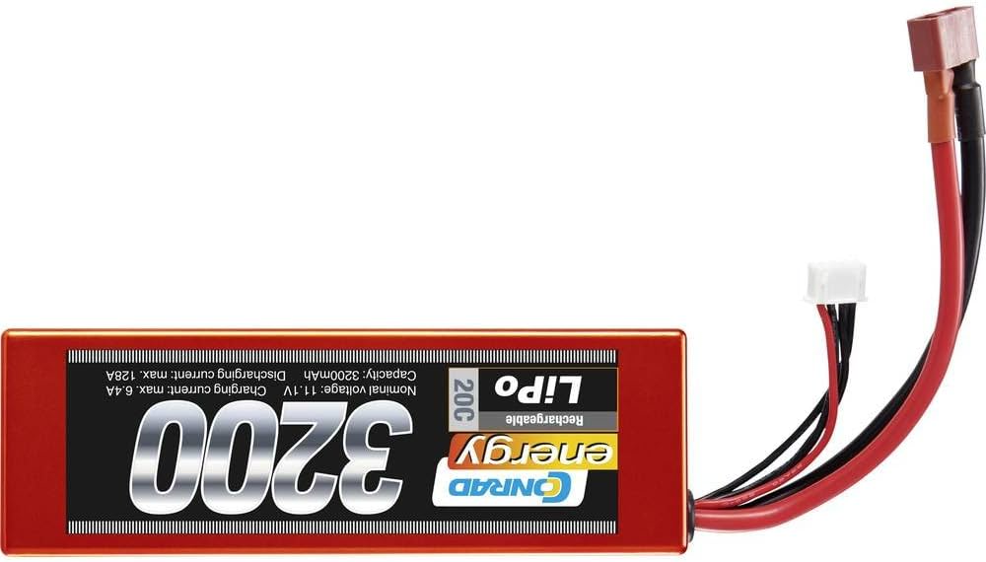
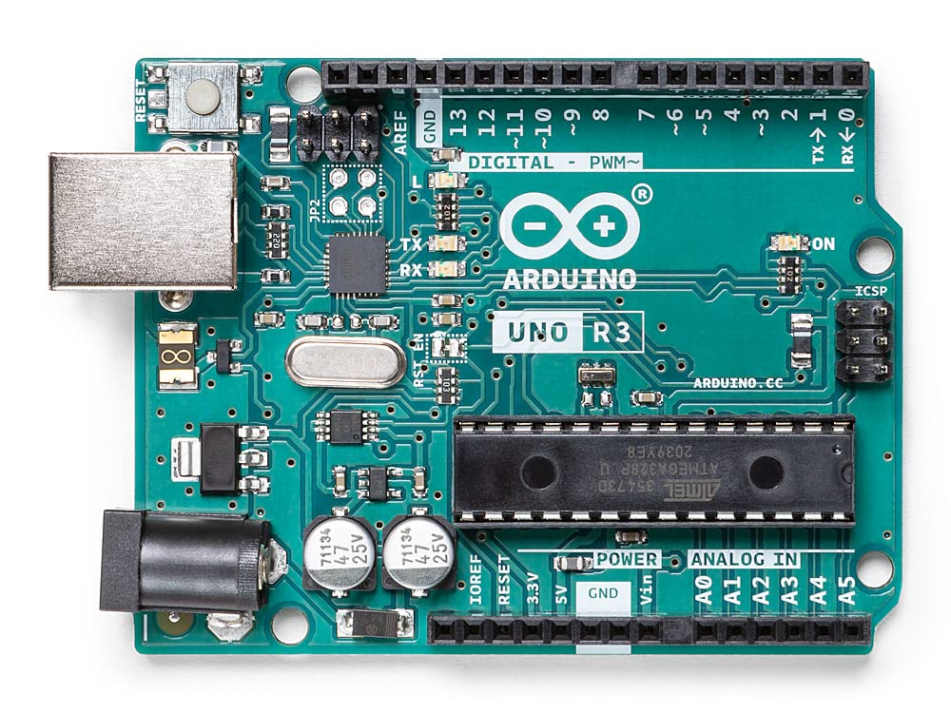
MICROCONTROLLER AND POWER SOURCE
• 5V Input
• 14 Digital Pins
• 6 Analog Pins
• Used with
Arduino IDE
• Technology LiPo
• Cell number 2
• Tension 7.4V
• Capacity 3000mAh
• Resilience 20C
• Weight 210g
[4]
7

Slide 9
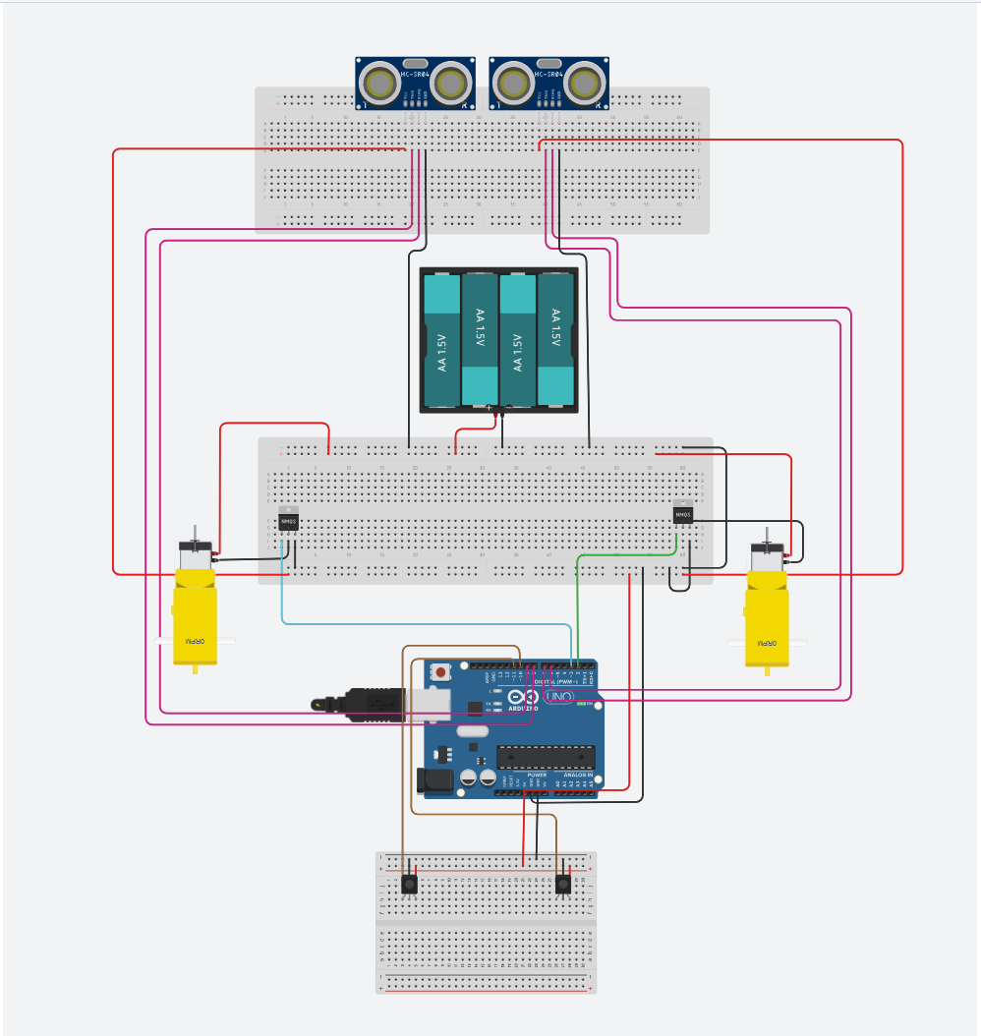
COMPLETE SCHEMATIC
[5]
8

Slide 10
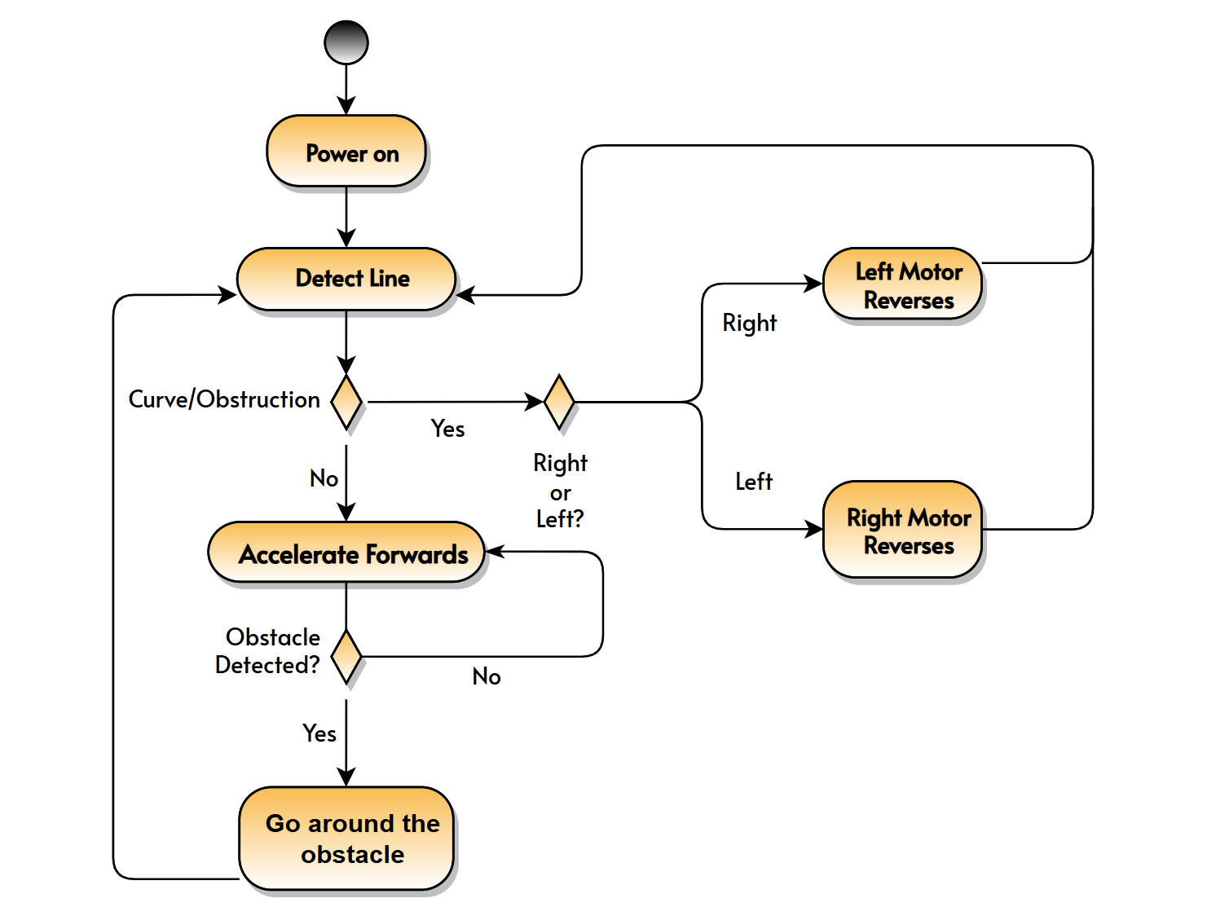
ACTIVITY DIAGRAM
9

Slide 11
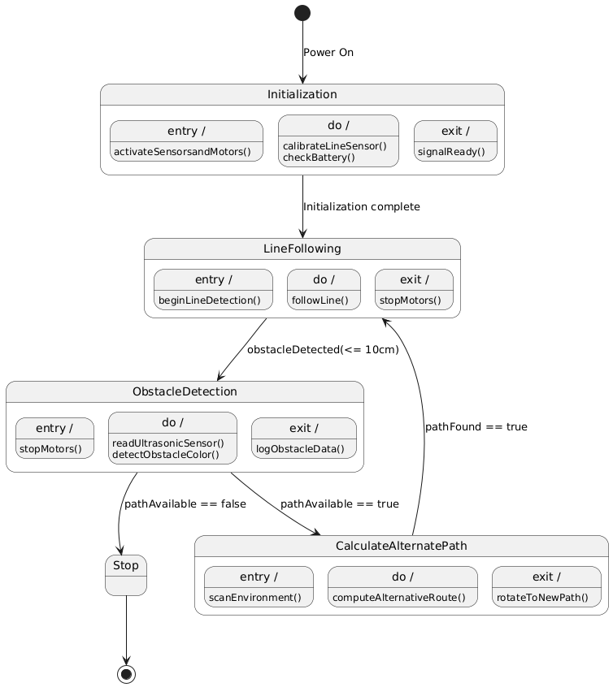
STATE MACHINE DIAGRAM
10

Slide 12
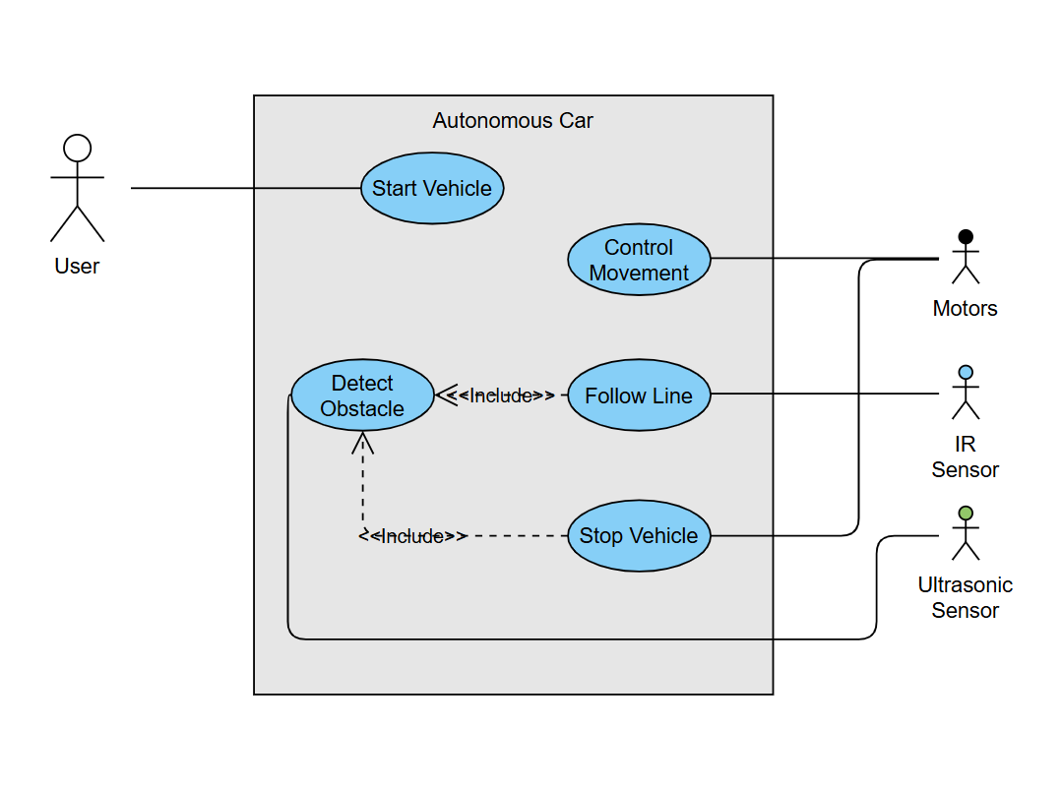
USE CASE DIAGRAM
11

Slide 13
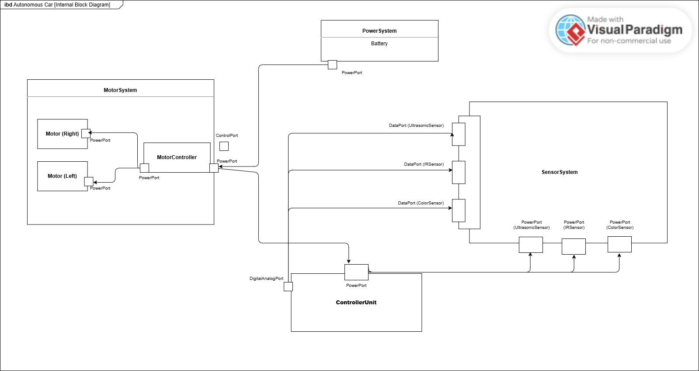
Internal Block Diagram
12

Slide 14
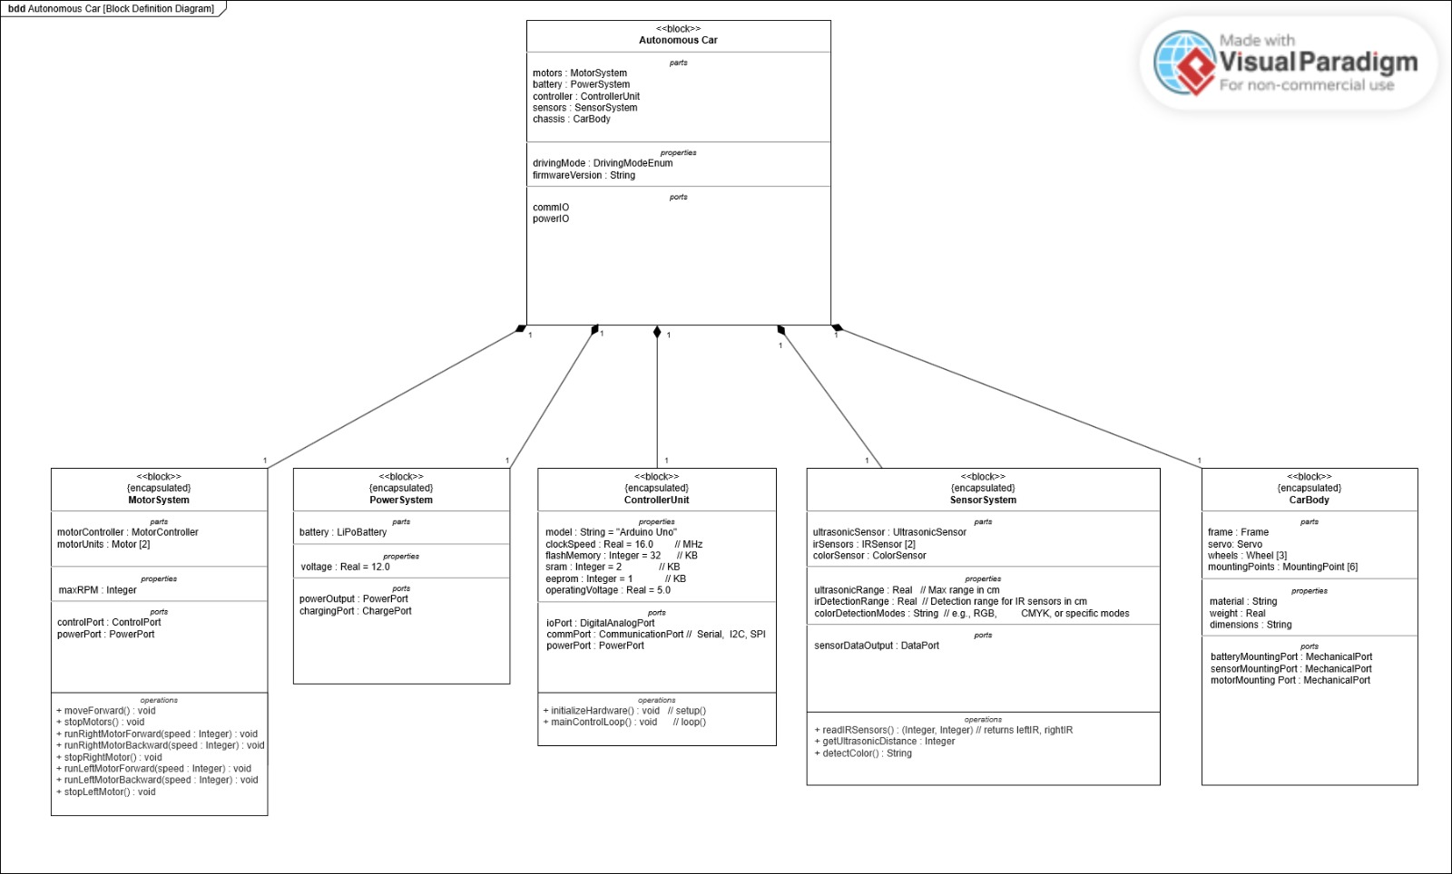
Block Definition Diagram (BDD)
13

Slide 15
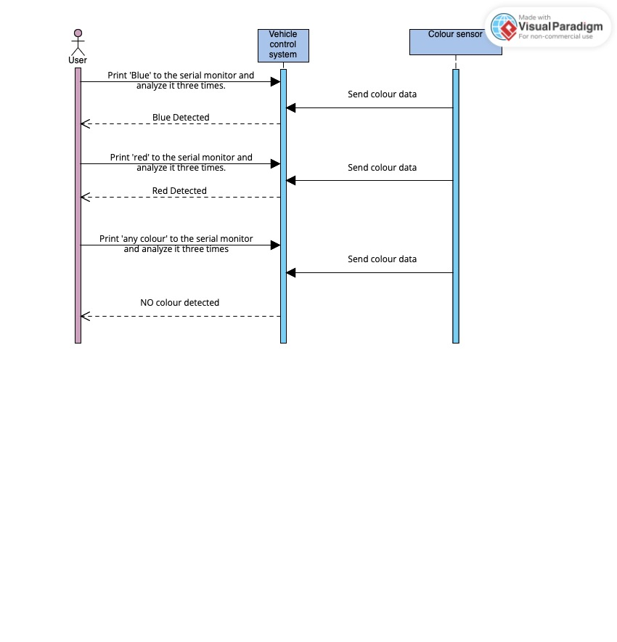
INTERACTION STRUCTURE
FOR COLOUR EVALUATION
14

Slide 16
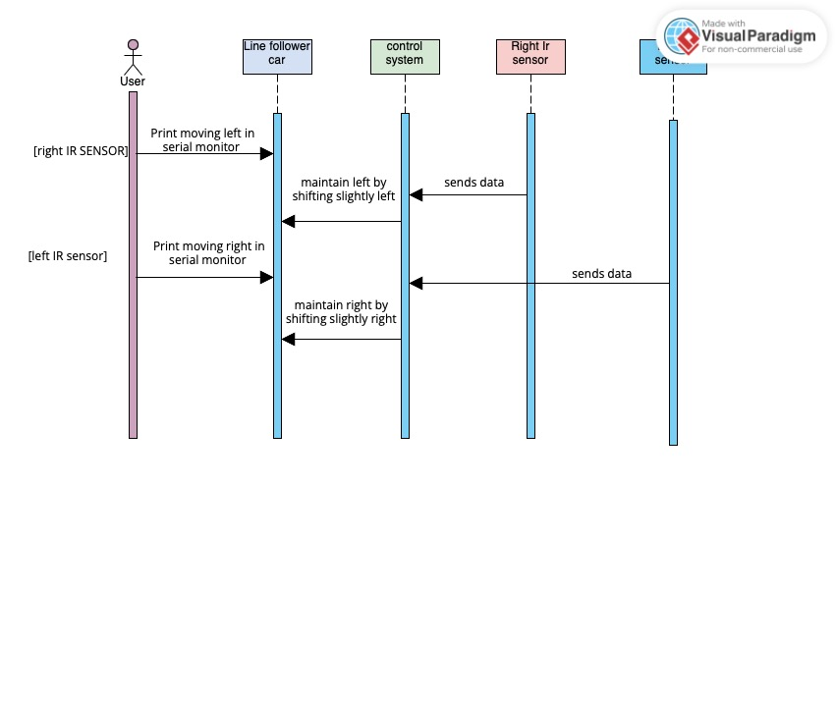
INTERACTION STRUCTURE FOR FOLLOWING LINE
15

Slide 17
Outcomes and Achievements
Can Follow a Line? ✓
Can Take Turns at any angle (i.e 90 degree turn)? ✓
Can optimize speed ? ✓
Can detect obstacles? ✓
Can evaluate colour of Object? ✓
Can take 180 degrees turn? ✓
Can overtake an obstacle? ✓
Can park? ✓
16

Slide 18
FUTURE WORK:
Four-wheeled autonomous vehicle prototype
Servo motors mounted at the front and back to rotate ultrasonic sensors for environmental scanning
Current use of Arduino may be limiting due to insufficient digital pins
Considering switching to a different microcontroller with more I/O capabilities
Possible integration of a Real-Time Operating System (RTOS) for improved responsiveness and control
17

Slide 19
REFERENCES:
[1] Joy-IT, "Color sensor module TCS3200," Joy-IT.net, [Online]. Available: https://joy-it.net/de/products/SEN-Color. [Accessed: 21-Jun-2025].
[2] R. Santos, "Complete Guide for Ultrasonic Sensor HC-SR04 with Arduino," Random Nerd Tutorials, [Online]. Available: https://randomnerdtutorials.com/complete-guide-for-ultrasonic-sensor-hc-sr04/. [Accessed: 21-Jun-2025].
[3] Lextronic, "Capteur de ligne Arduino OpenST1140," Lextronic.fr, [Online]. Available: https://www.lextronic.fr/capteur-ligne-arduino-openst1140-51718.html. [Accessed: 21-Jun-2025].
[4] Components101, "L293D Motor Driver Module," Components101.com, [Online]. Available: https://components101.com/modules/l293n-motor-driver-module. [Accessed: 21-Jun-2025].
[5] Arduino, "Arduino UNO Rev3 with long pins (Retired)," Arduino Documentation, [Online]. Available: https://docs.arduino.cc/retired/boards/arduino-uno-rev3-with-long-pins/. [Accessed: 21-Jun-2025].
[6] Autodesk, "Tinkercad Circuits: Online Simulator for Arduino and Electronics," Tinkercad.com, [Online]. Available: https://www.tinkercad.com. [Accessed: 21-Jun-2025].
18

